Slide 1
From: Sustainable Modernity: the Nordic Model and Beyond (forthcoming 2018)
Is there a Nordic Humanism?

Slide 2
OECD
Gini Coefficient 2014

Slide 3
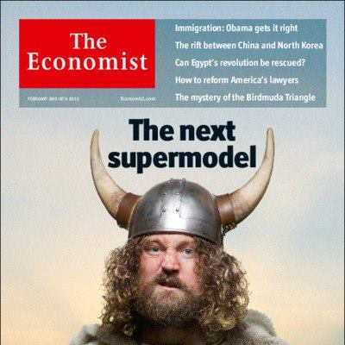
Nordic model: Towards a the “Wellbeing Society”
• Out of 13 times, the Nordic countries have ranked 11 times as the “best countries to live in” (according to the UNDP)
• Best countries for mothers;
Top scorers in CSR;
Low Gini coefficient;
High level of trust;
Norway: The happiest country on earth?

Slide 4
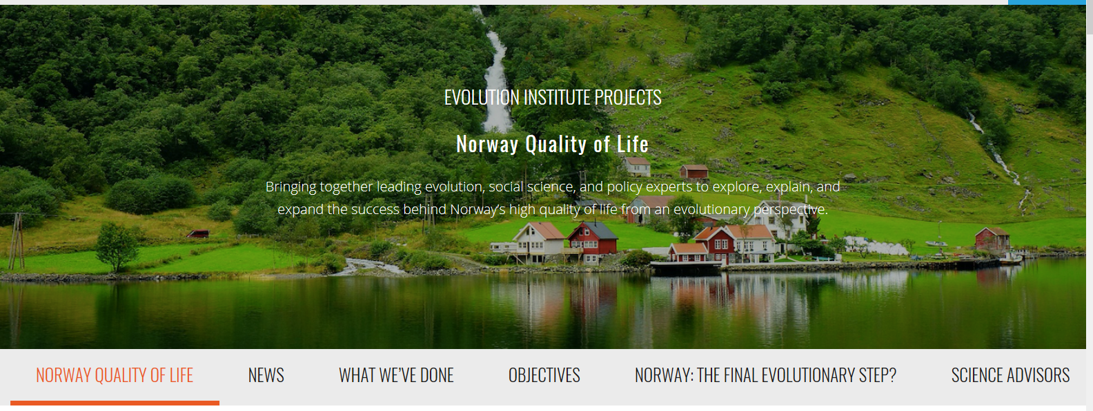
Collaboration with the Evolution Institute (US), University of Oslo, Norwegian Business School (BI), and Stockholm University.

Slide 5
Ostrom’s Design Principles of Sustainable Communities
1) Define clear group identity and boundaries.
2. Match rules governing use of common goods to local needs and conditions.
3. Ensure that those affected by the rules can participate in modifying the rules.
4. Make sure the rule-making rights of community members are respected by outside authorities.
5. Develop a system, carried out by community members, for monitoring members’ behavior.
6. Use graduated sanctions for rule violators.
7. Provide accessible, low-cost means for dispute resolution.
8. Build responsibility for governing the common resource in nested tiers from the lowest level up to the entire interconnected system.

Slide 6
Pastoral Enlightenment: Scandinavian Founding Tradition
‘Pastoral’: refering to the pivotal role of Lutheran priests in shaping the national ethos (based on Christian ideals), but also to durable ‘rustic’ component in the national identity: flaunting ‘virtuous countryside’ against ‘sinful city’, idealized free peasantry, and the dream of simple Spartan life in nature (‘primordial home’).
Key values: the ideal of hard work, personal responsibility, social cooperation (dugnad), rationality (belief in ‘reasonable God’ and ‘reasonable nature’), distrust of conspicuous consumption, belief in progress, orientation towards the future rather than a ‘golden past’, pragmatism rather than romanticism.

Slide 7
Scandinavian Symbotypes
Norwegian «Community of Goodness»
Swedish «Caring Home» ( folkhemmet)
Danish «Happy Christianity» (with or without God)

Slide 8
‘Haugianerne’ (Adolph Tidemand, 1848)

Slide 9
Hans Nielsen Hauge (1771-1824): early precursor of peasant empowerment, gender equality and ‘civilized capitalism’

Slide 10
N.F.S. Grundtvig (1883-1872): yhe author of Danish ‘happy Christianity’

Slide 11
Selma Lagerlöf (1858-1940): the catalyst of the folkhemmet and gender partnership

Slide 12
Henrik Wergeland (1808-1845): the animateur of Norwegian altruist and inclusive community

Slide 13
Bjørnstjerne Bjørnson (1832-1910) and Fridtjof Nansen (1861-1930) : Precursors of a ‘Humanitarian Norway’

Slide 14
Georg Brandes (1842-1927): Aesthetic Enlightenment

Slide 15
Dag Hammarskjöld (1905-1961): the Precursor of Humanist Universalism

Slide 16
Frans Emil Sillanpääm (Nobel Prize in Literature, 1939): The praise of the “middle ground”

Slide 17
Carl Gustaf Mannerheim: a model of non-partisan, anti-authoritarian conservatism

Slide 18
Tove M. Jansson, the feminist mythology of the Moominland series

Slide 19
Georg von Wright: Ecological Humanism

